Slide 1
Software Technologies CS5183 (Spring-2017)
Automating Publication Management System
Members : Mrinal Aich, Vinod Chhapariya, Tulja Vamshi Kiran, Neeraj Kumar
Mentor : Prof.Manohar Kaul
Dept. of CSE, Indian Institute of Technology, Hyderabad

Slide 2
Introduction
The Current Publication Management System(PMS) of CSE
Shows all scientific publications from the current faculties.
Shows profile of each faculty with their research areas and publications.
Search/browse for publications based on name, research area, author name and year of publication.
The system updated manually and contains many issues/bugs.

Slide 3
Objectives
Complete Automation of the system.
Add publication by checking faculty’s Google scholar profile.
Provide comparison of research work among different IITs.
Automated creation and deletion of faculty profiles.
Inform CSE IITH community about new publication by a current faculty. (via research@cse.iith.ac.in)
Improve on User-perspective of the system and sync with Dept. Homepage.

Slide 4
Quick Demonstration of the new System
Homepage
Faculty Profile Page
Improved Search
Research Work Comparison

Slide 5
Technical Aspects (1/2)
Automation is implemented through Periodic scripts.
Google Scholar account of each faculty is crawled every 24 hours.
CSE Faculty Web Page is crawled once in a month.
Add Publications(by Crawling) faculty’s Google Scholar Profile.
Use of Faculty Web Page to automate Creation and Deletion of faculty profiles.
Notification mail is sent to CSE IITH community about a new publication.
Inform New Faculty about his profile creation.

Slide 6
Technical Aspects (2/2)
To compare the quantity of research going-on across IITs, year-wise research work by current professors of various IITs is maintained.
The comparison can be designation-wise, year-wise and institute-wise.
The search functionality gives very good Recall with high Precision.
Improved front end to go with our website.
Track locally the publications already crawled using JSON file.

Slide 7
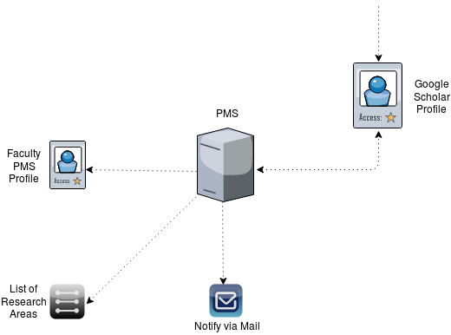
Adding Publication - Flow Diagram (1/4)
1. Publication Added
3. Adds publication details
2. Periodically checks for Updates (24 hours)
4. Updates
5. Notify

Slide 8
Publication Add - Demonstration - (1/4)
Create a ‘Test faculty’ Google Scholar Profile with a publication.
Add ‘Test faculty’ Information into the system.
Script detects and crawls for his publications.
Publication details added and subsequent updates.
Notify everyone in the CSE community about it.

Slide 9
Demo Video

Slide 10
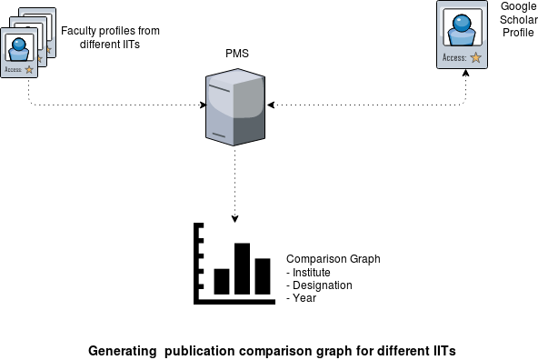
Comparison Work - Flow Diagram (2/4)
1. Add faculty details of each IIT
2. Get Year-wise publication count for each faculty
3. Generate Graph

Slide 11
Research Work Comparison - Demonstration - (2/4)
Collect Information of all faculties in different IITs.
Store the Year-wise publication count of each faculty.
Compare either year-wise, designation-wise and institute-wise.

Slide 12
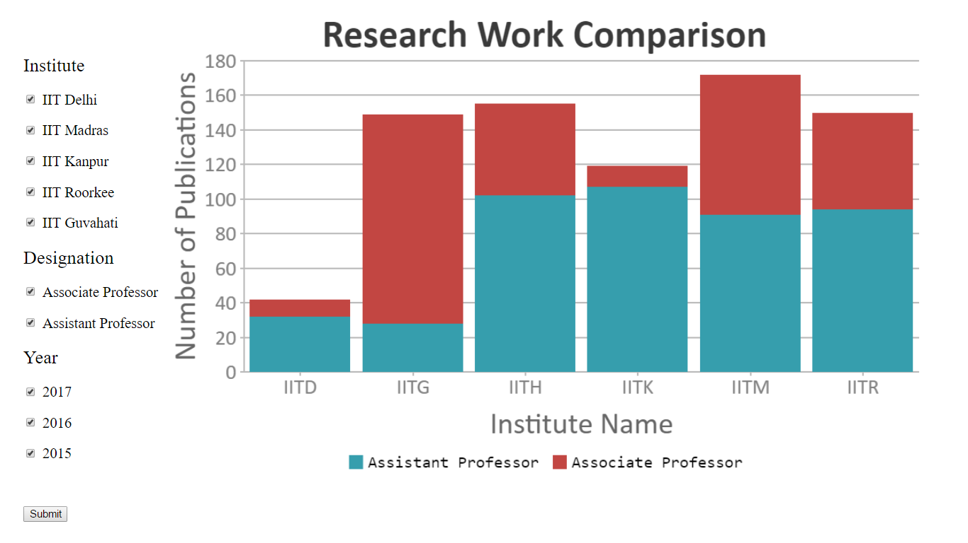
Shows combined Research work of both Associate and Assistant Professors from 2015-2017, over different IITs.

Slide 13
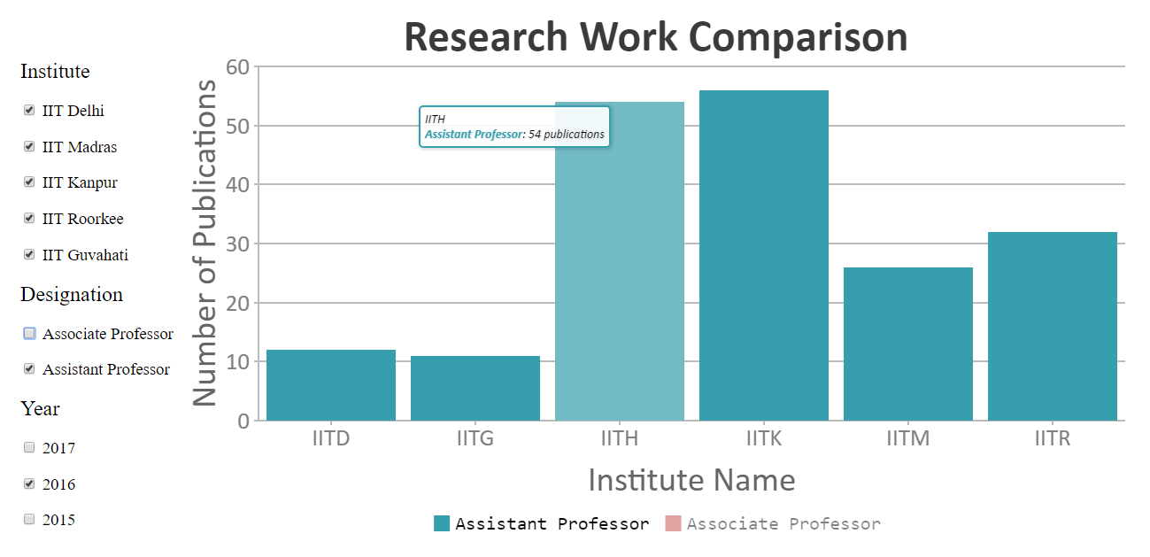
Shows Research work of Assistant Professors in 2016, over different IITs.

Slide 14
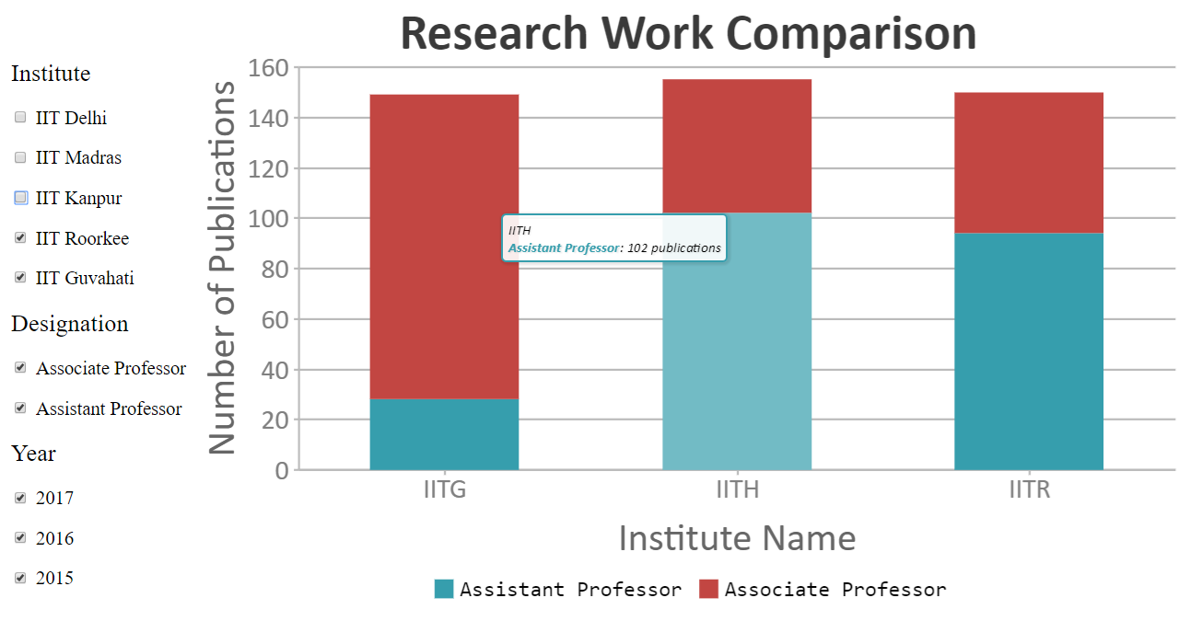
Shows Research work by Associate and Assistant Professors during 2015-2017, at IIT Guwahati, IIT Hyderabad and IIT Roorkee.

Slide 15
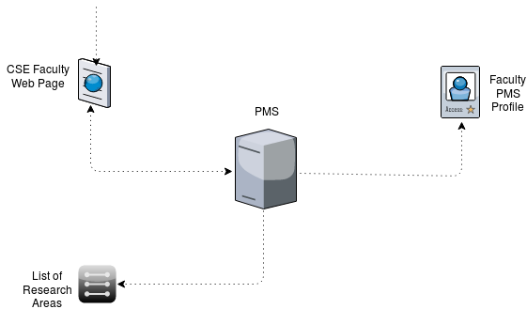
Faculty Leaves - Flow Diagram (3/4)
1. Entry removed by CSE Web Team
2. Periodically check for updates (1 month)
3. Deletes Faculty Profile
4. Updates

Slide 16
Faculty Leaves - Demonstration - (3/4)
Tweak the database to remove a faculty information.
Periodic script detects the update.
All related information regarding the faculty is deleted. E.g. Profile, Publications, Research Area (if faculty was working alone in that field)

Slide 17
Demo Video

Slide 18
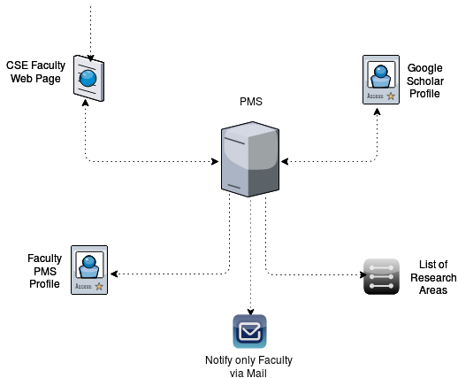
Faculty Joining - Flow Diagram (4/4)
1. Entry added by CSE Web Team
2. Periodically checks for updates (1 month)
3. Checks for Faculty’s Google Scholar Profile
4. Creates Faculty Profile
5. Updates
6. Notify

Slide 19
Faculty Add - Demonstration - (4/4)
Remove the previous tweak.
Periodic script detects that a faculty has joined.
All related information regarding the faculty is added. E.g. Profile, Publications, Research Areas.
Notification (via mail) is sent to the faculty about his profile creation.

Slide 20
Demo Video

Slide 21
Dependencies
Not all faculties have their Google Scholar account.
Google Scholar detects crawling and temporarily blocks the access.

Slide 22
Issues of Existing PMS System

Slide 23
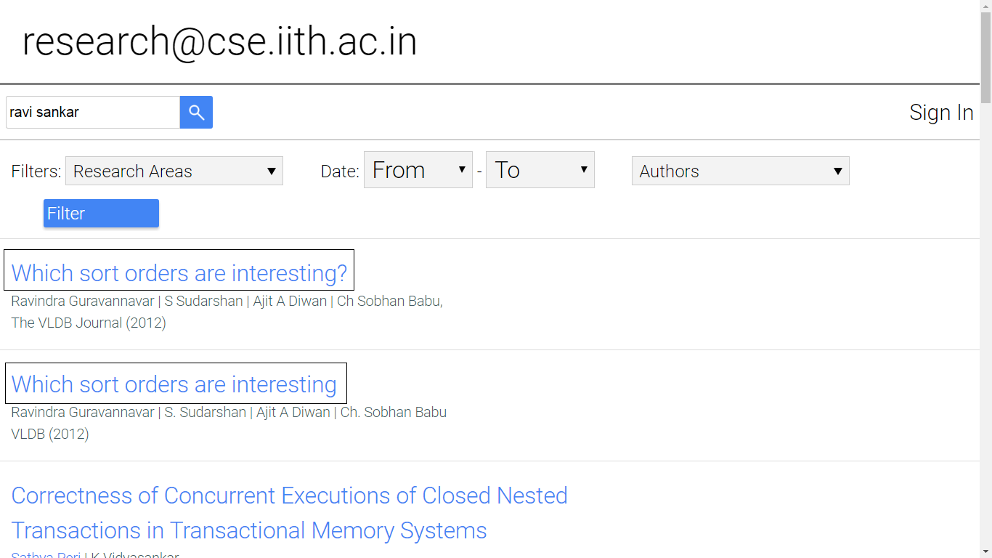
Redundancy in the Output

Slide 24
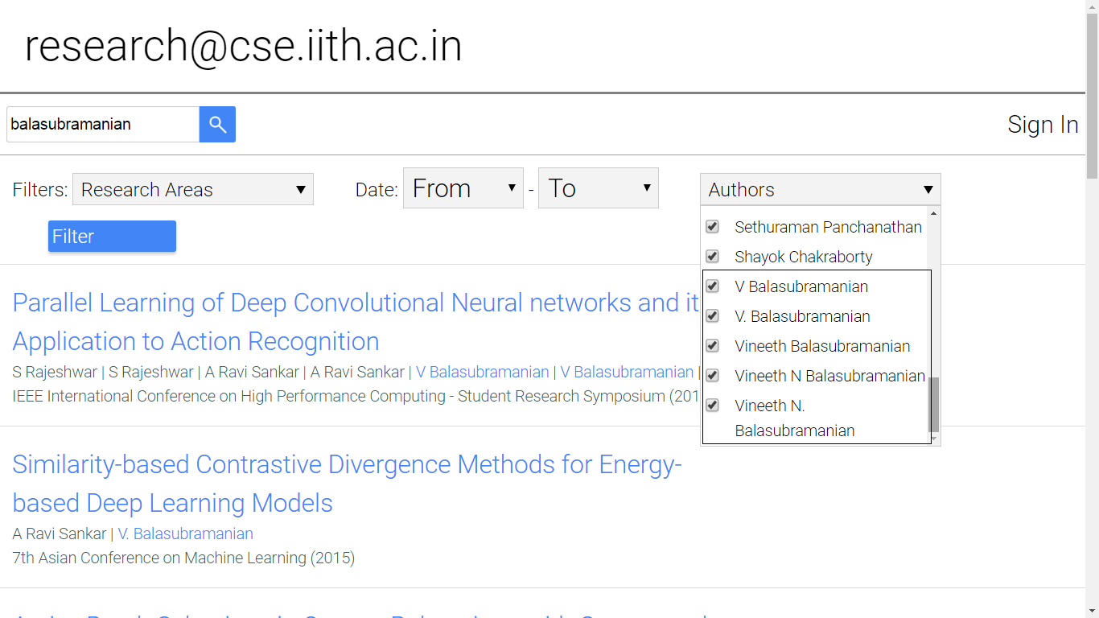
2. Same Author with multiple names

Slide 25
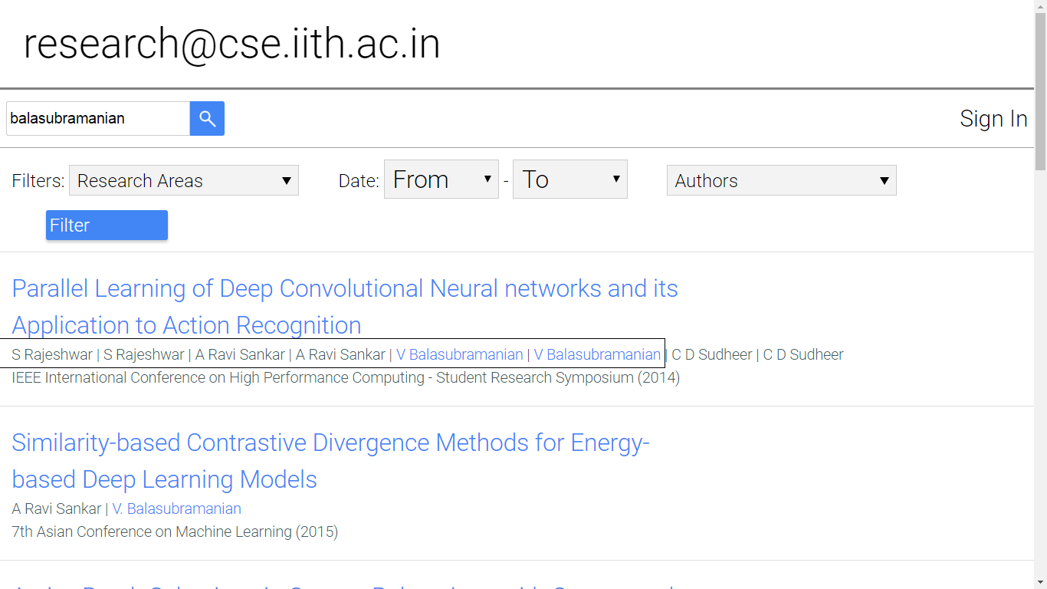
3. Co-authors repetition

Slide 26
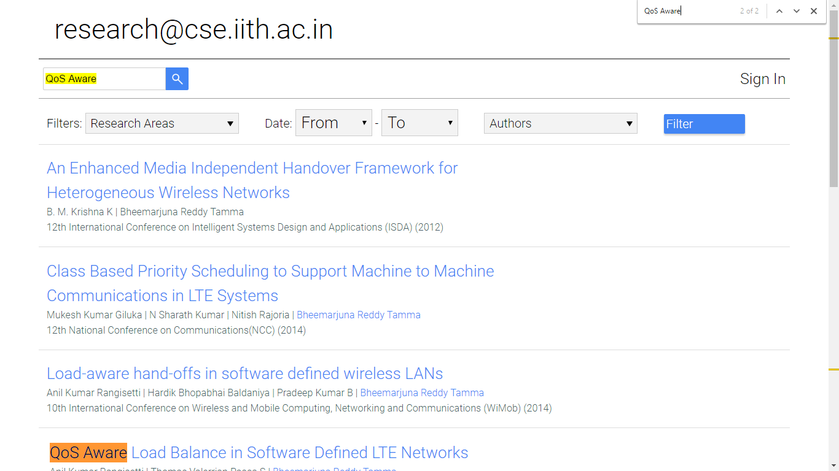
4. Low Precision Search

Slide 27
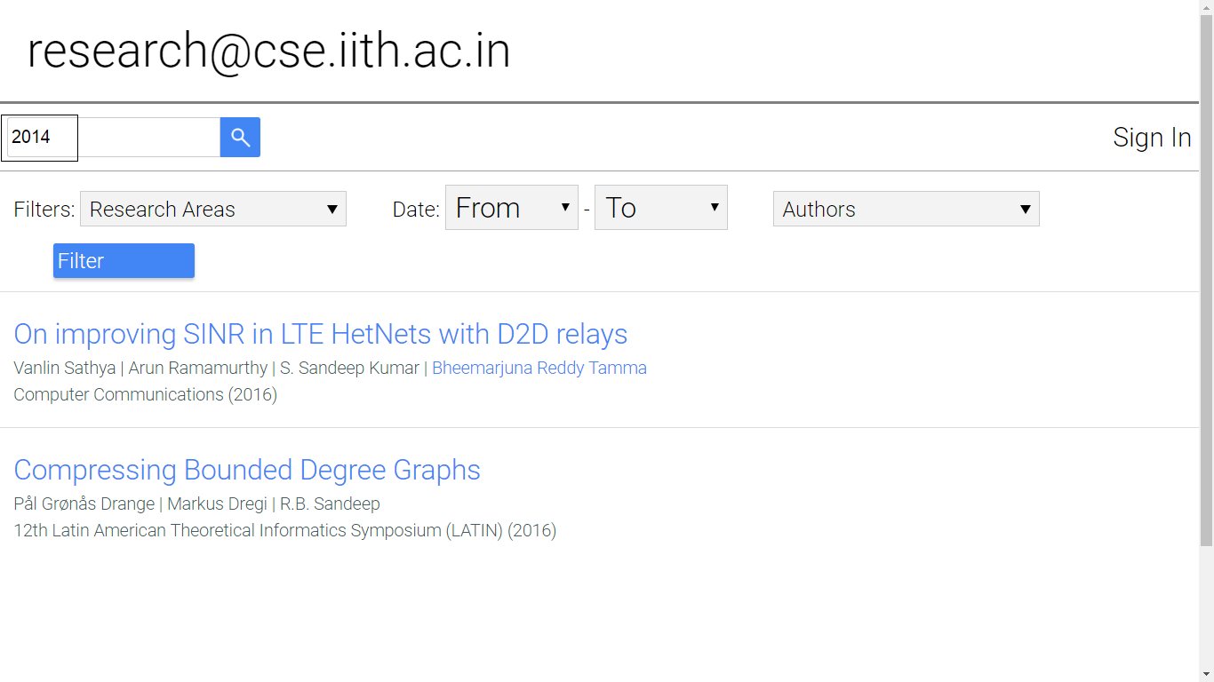
5. Low Recall Search

Slide 28
Future Work
Deployment at the CSE Web Server.
Machine translation of foreign languages (non-ASCII characters).

Slide 29
Thank You

